Slide 1
Micro Market Mapping
App Upgrades for scale up

Slide 2

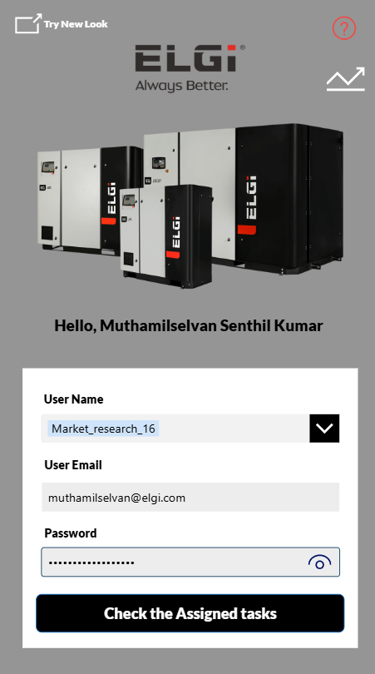
Log In Screen
Old Version
New Version
Features Upgrades:
Password removed now user can login without password
User Roles created for better suggestion user defined automatically based on the AD. Roles mentioned below
Admin ( Can able to see all the records )
Dealer User ( Can Able to see all the records belongs to Dealer )
Intern ( Can able to see only their record )
ELGi User ( Can able to see only their record )
Look enhanced
Log in Speed Optimized with new performance engine

Slide 3
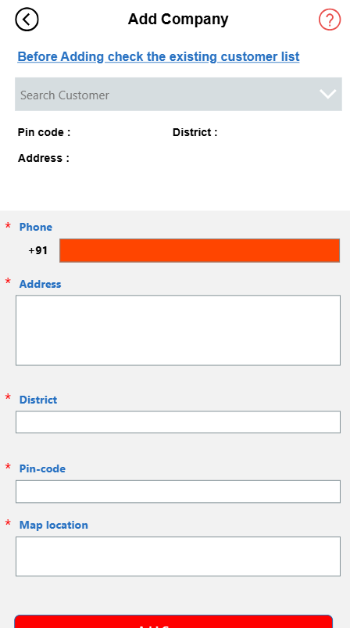
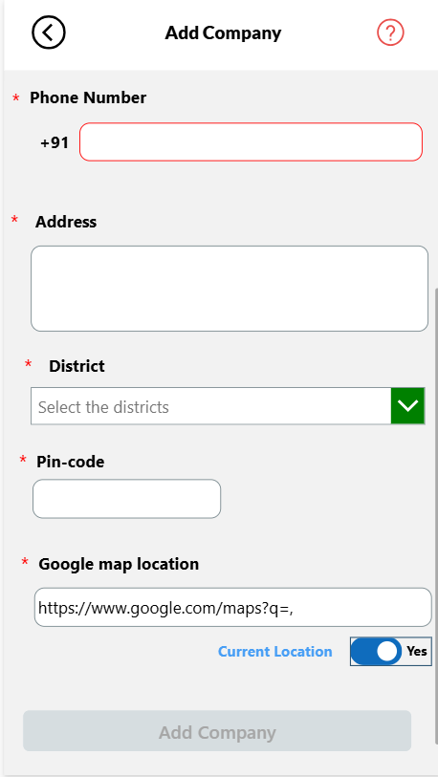
Adding New Company Page
Old Version
New Version
Features Upgrades:
District search option provided
Map current location fetching option provided
Pin code validation provided
Look enhanced
Performance Optimized with new performance engine

Slide 4
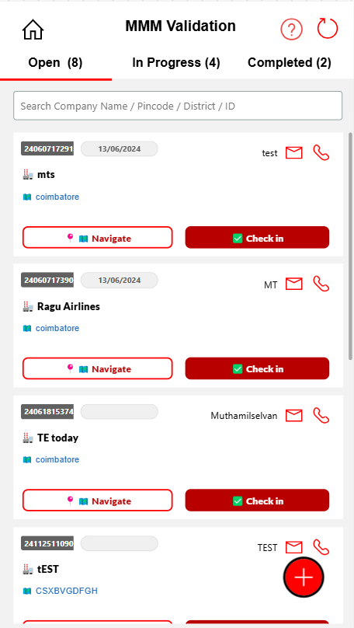
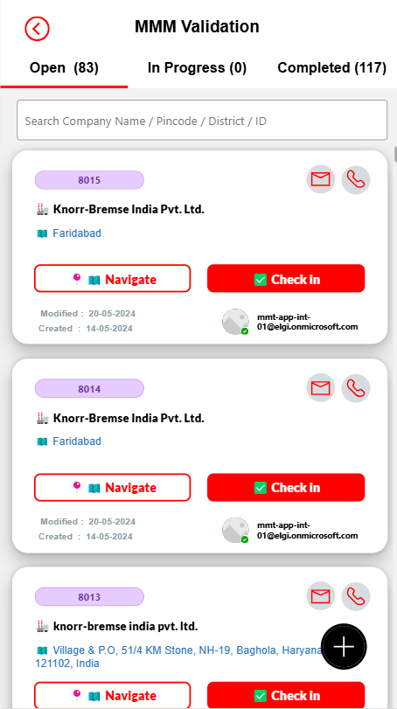
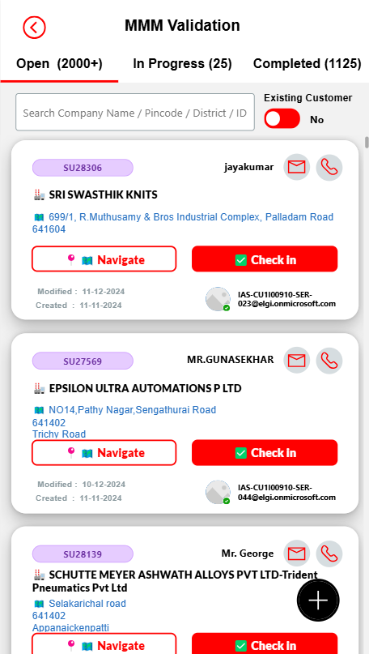
Open Visit Page
Old Version
New Version
Intern
DSE
Features Upgrades:
Existing customer filter provided for dealers. Because Dealer service engineers may only visit existing customers
Owner ID mentioned in data card
Modified Date provided in data card
Created date provided in data card
Look Optimized
Performance Optimized with new performance engine

Slide 5
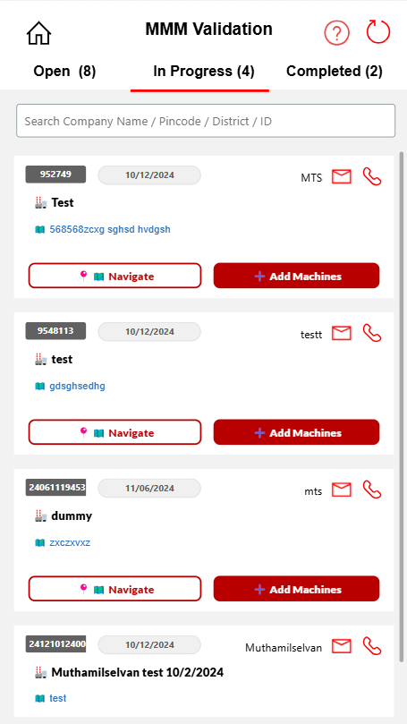
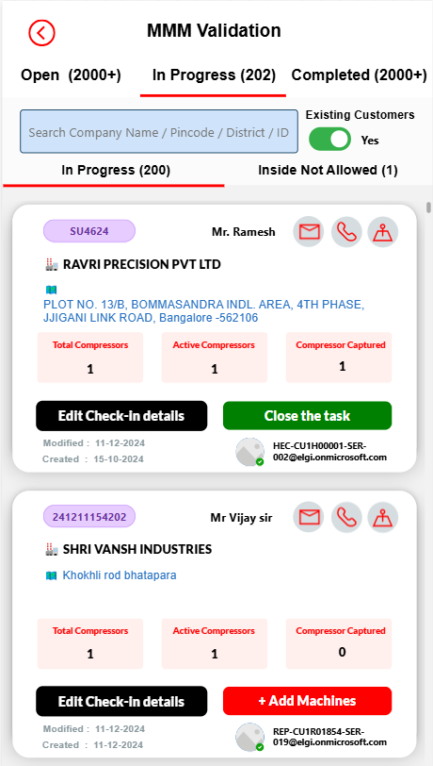
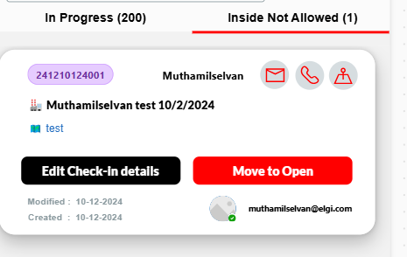
In progress Visit Page
Old Version
New Version
Features Upgrades:
If not allowed inside the plant that will be stay inprogress in the in progress page in different tab. From there user can reopen and do visit again.
Existing customer filter provided for dealers. Because Dealer service engineers may only visit existing customers
Compressor having and compressor added details added in the data card
User can able to edit the task directly instead of moving to open
Owner ID mentioned in data card
Modified Date provided in data card
Created date provided in data card
Look Optimized
Performance Optimized with new performance engine

Slide 6
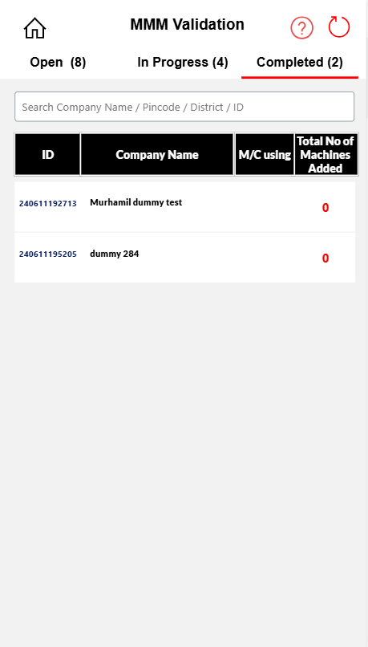
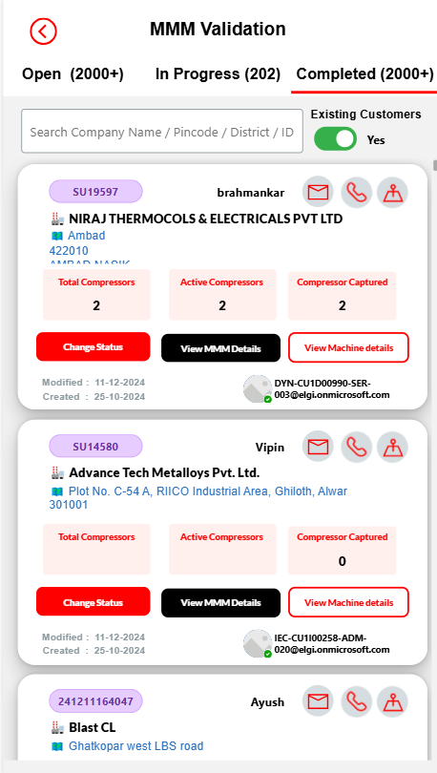
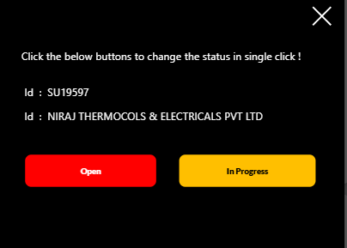
In progress Visit Page
Old Version
New Version
Features Upgrades:
Existing customer filter provided for dealers. Because Dealer service engineers only visit existing customers
Compressor having and compressor added details added in the data card
User can reopen or move in progress by clicking the change status button
Owner ID mentioned in data card
Modified Date provided in data card
Created date provided in data card
Look Optimized
Performance Optimized with new performance engine

Slide 7
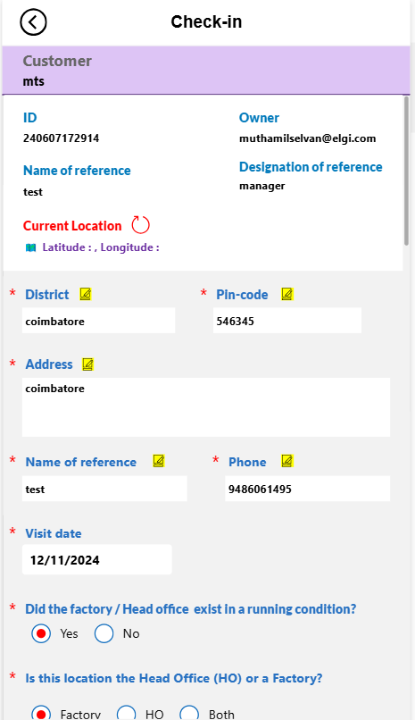
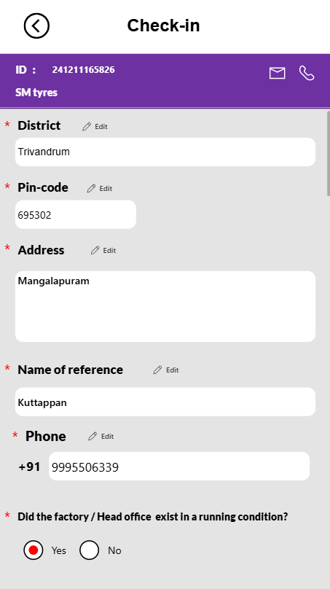
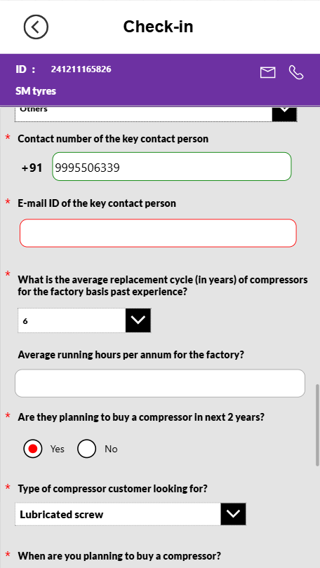
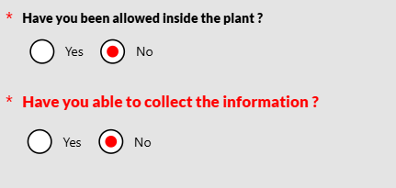
Check-in Page & Edit Page
Old Version
New Version
Features Upgrades:
New algorithm implemented to reduce the manual error.
If inside factory was not allowed additional question will be asked like are the able to collect the information.
Mobile number validation provided
Email validation provided
Data Saving method improved
Look Optimized
Performance Optimized with new performance engine

Slide 8
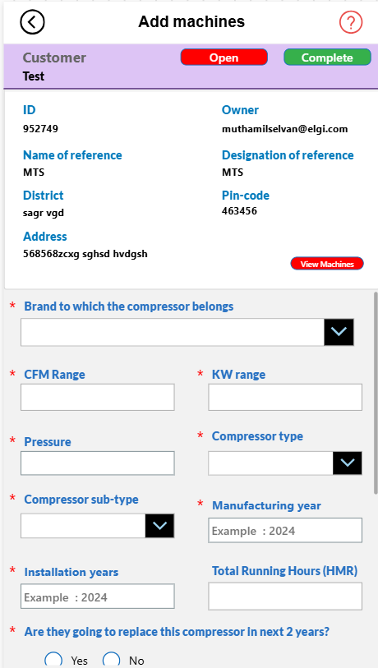
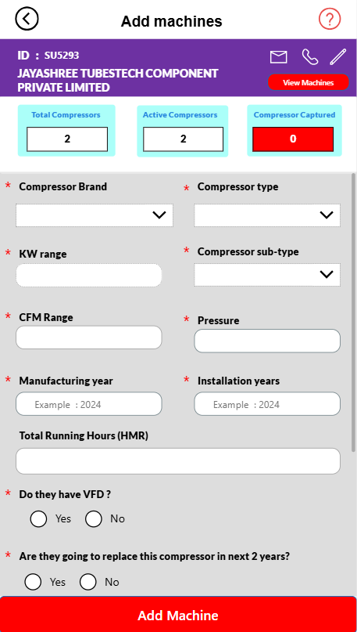
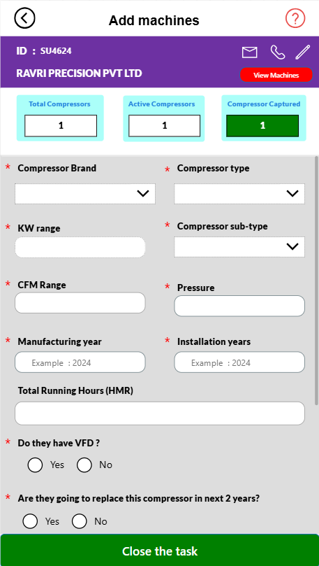
Add machine Page
Old Version
New Version
Features Upgrades:
Compressor having and compressor added details added in the data card
User can able to edit the details from add machine page
User can close the task if all the machine was added,red and green color given for understanding
Look Optimized
Performance Optimized with new performance engine

